Slide 1
Predicting Heart Disease
Prem Panchal
Data Science Capstone Project

Slide 2
The Problem
Heart disease major issue
Possible ways to detect it faster?
How would a person know they need to get checked up?

Slide 3
Steakholders
Hospitals
Medical Clinics
Company owners where employees are at risk for heart related disease

Slide 4
Dataset
Combination of 5 heart data sets, combined in 2021
Cleveland: 303 observations
Hungarian: 294 observations
Switzerland: 123 observations
Long Beach VA: 200 observations
Stalog (Heart) Data Set: 270 observations
Total: 1190 observations Duplicated: 272 observations
Final dataset: 918 observations

Slide 5
Possible Symptoms
Age
Heart Pain Types
Cholesterol
Hereditary causes

Slide 6
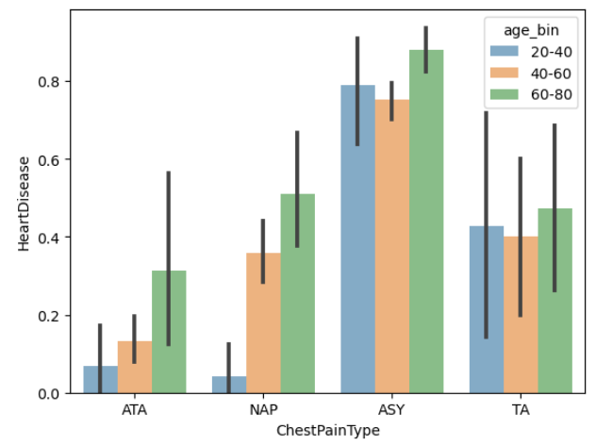
Chest Pain Types
ATA - Atypical Angina
NAP - Non-Anginal Pain
ASY - Asymptomatic
TA - Typical Angina

Slide 7
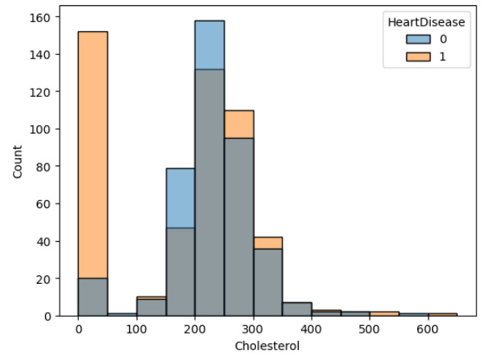
Cholesterol
No Direct Correlation
Many cases with heart disease actually have a cholesterol of 0
High cholesterol can be caused by both hereditary issues or dietary issues
Added new feature into Data set to accommodate hereditary cases

Slide 8
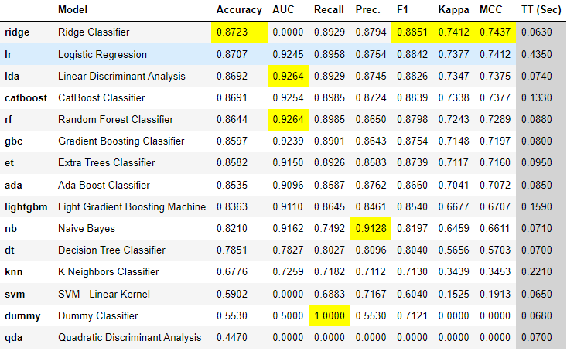
Model Comparisons
Supervised learning
Binary Classification
Fairly even classification distribution

Slide 9
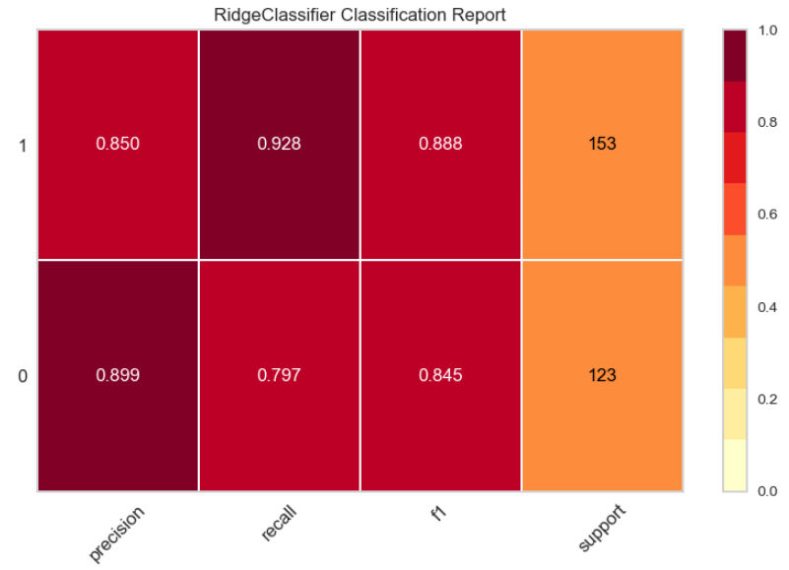
Model Performance

Slide 10
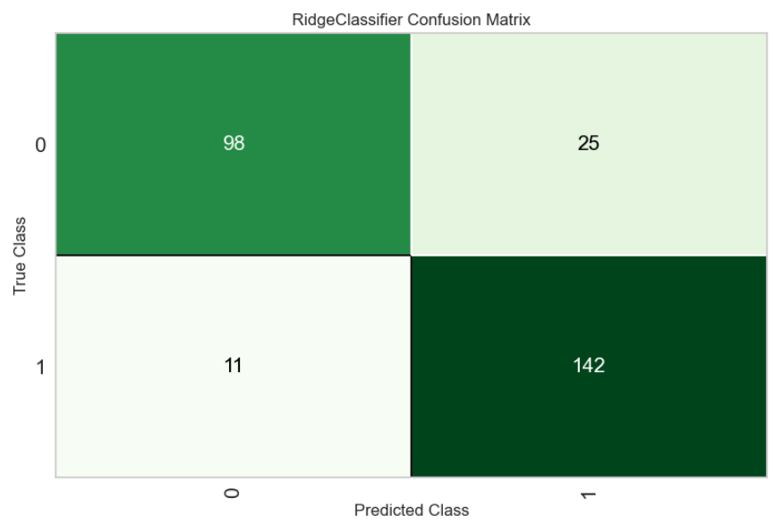

Slide 11
Model Improvements
Obtain more data
Possibly through synthetic medical data
Look into other features that could make the data more accurate

Slide 12
Conclusion
Ridge Classifier most accurate model
While highly accurate only serves as a baseline
Ideally available to both patients and doctors to determine more extensive testing
Adding more data to the model iteratively can help doctors more quickly determine if testing needs to be done

Slide 13
Thank you!
Prem Panchal
Email: prem0217@gmail.com
Project: https://github.com/prem-0217/CapstoneTwo

